Slide 1
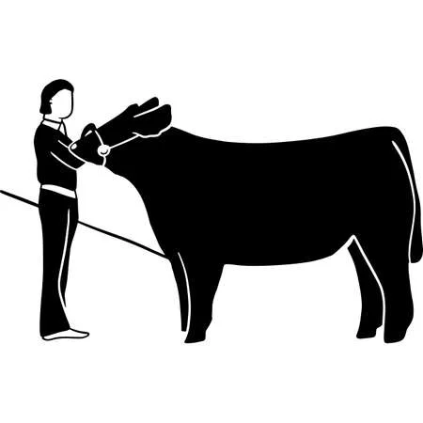
Heifers
What does it cost to show...
Cost of animal: $2000
Cost of feed per week: $40
Weeks on feed: 35
Supplies for the year: $300
Extras (entry fees, vet bills, etc.): $300
Total Investment Cost per year: $4000

Slide 2
Steers
What does it cost to show...
Cost of animal: $2000
Cost of feed per week: $40
Weeks on feed: 48
Supplies for the year: $280
Extras (entry fees, vet bills, etc.): $300
Total Investment Cost per year: $4500

Slide 3
Swine
What does it cost to show...
Cost of animal: $600
Cost of feed per week: $30
Weeks on feed: 18
Supplies for the year: $160
Extras (entry fees, vet bills, etc.): $200
Total Investment Cost per year: $1500

Slide 4
Sheep
What does it cost to show...
Cost of animal: $500
Cost of feed per week: $30
Weeks on feed: 24
Supplies for the year: $170
Extras (entry fees, vet bills, etc.): $200
Total Investment Cost per year: $1600

Slide 5
Goats
What does it cost to show...
Cost of animal: $500
Cost of feed per week: $30
Weeks on feed: 24
Supplies for the year: $170
Extras (entry fees, vet bills, etc.): $200
Total Investment Cost per year: $1600

Slide 6
Chickens
What does it cost to show...
Cost of animal (50): $100
Cost of feed: $500
Weeks on feed: 6
Supplies for the year: $250
Extras (entry fees, vet bills, etc.): $50
Total Investment Cost per year: $900

Slide 7
Rabbits
What does it cost to show...
Cost of animal (3): $300
Cost of feed: $200
Weeks on feed: 12 +
Supplies for the year: $400
Extras (entry fees, vet bills, etc.): $50
Total Investment Cost per year: $950

